Slide 1
Steps for how to apply passport and visa

Slide 2
1. Determine the type of visa you need
Tourist Visa – Passport with "Tourist Visa" stamp, tropical destinations, or suitcase.
Work Visa – Image of a work permit, business attire, office setting.
Student Visa – Passport with "Student Visa" stamp, student ID, or university setting.
Business Visa – Formal business meeting, passport, or travel documents.
Immigrant Visa – Family with luggage at the airport, new home, or country flag.
Transit Visa – Image of a layover scene at an airport.
Medical Visa – Passport, hospital/clinic, or health symbol.
Investor Visa – Financial documents, money, and passport visuals.

Slide 3
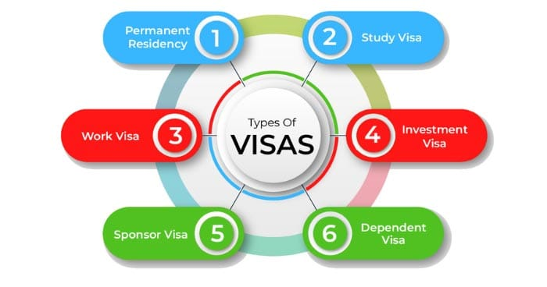
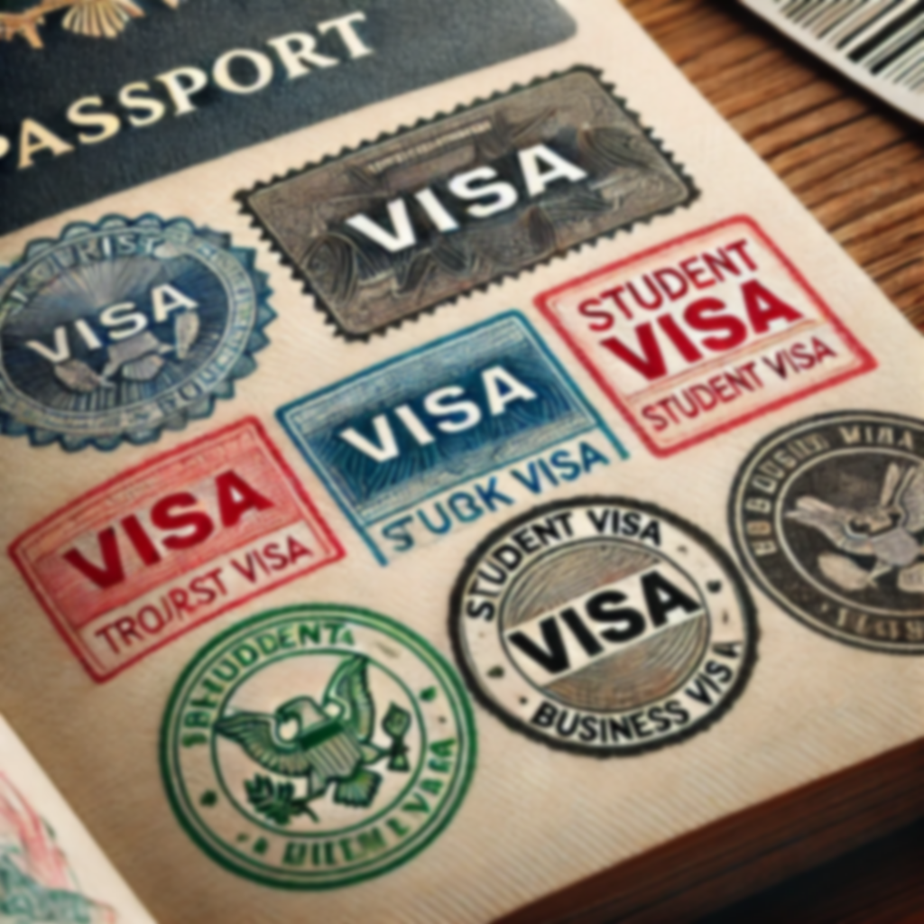
Visa types

Slide 4
2. Research the Specific Requirements
Check the official website of the country’s embassy or consulate: Look for up-to-date information on what documents are needed for the visa you want to apply for.
Processing time: Some countries require months for processing, while others may have expedited options.
Fees: Most visa applications require a fee, which varies by visa type and country.
Valid passport: Ensure your passport is valid for the duration of your trip and beyond (usually at least 6 months from the intended entry date).

Slide 5
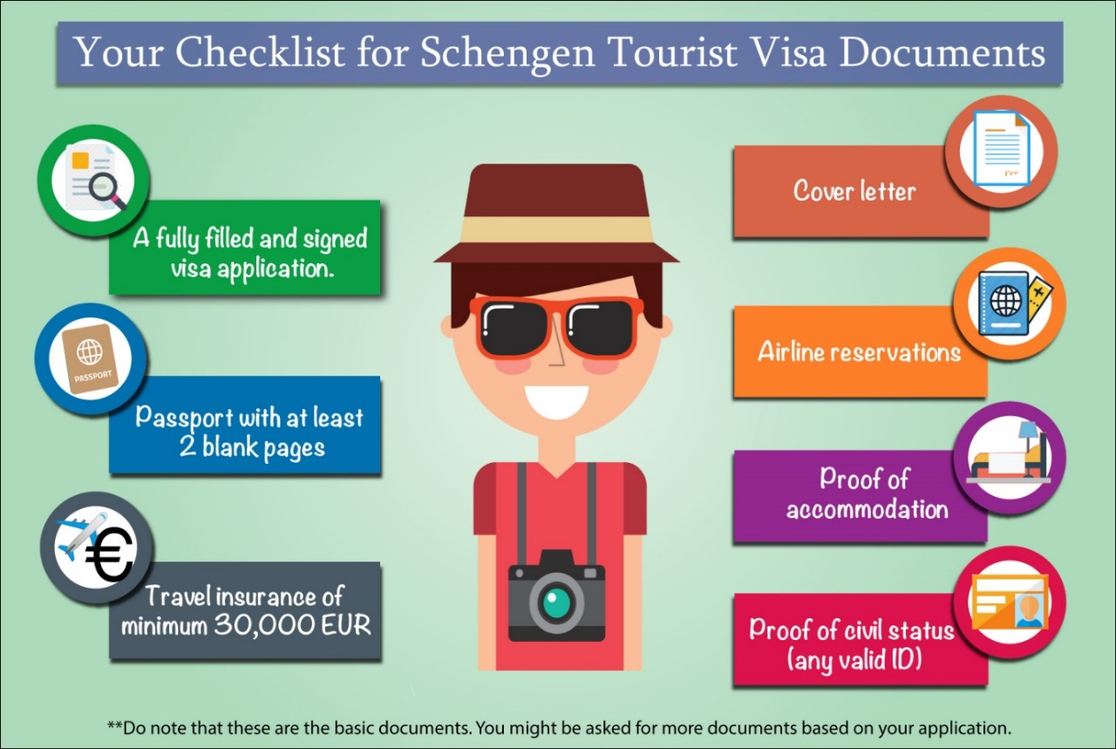

Slide 6
3.Prepare the Required Documents
Common documents needed include:
Passport: Valid for at least 6 months after your travel date.
Visa application form: Fill it out accurately.
Photographs: Passport-sized, meeting the specific requirements.
Proof of financial support: Bank statements, sponsorship letters, etc.
Travel itinerary: Flight tickets, accommodation details.
Invitation letter: For business, work, or family visits.
Health insurance: In some countries, you may need to show proof of health coverage for the duration of your stay.
Visa fee payment: Be prepared to pay any necessary fees.

Slide 7
4.Submit the Application
Online application : Many countries offer online visa applications where you can submit your form and documents digitally.
In-person submission : If required, schedule an appointment at the nearest embassy or consulate.
Visa application center: Some countries use third-party service centers where you can submit documents.

Slide 8
5.Attend an Interview (If Required)
Some countries may require a visa interview as part of the process. This is especially common for student or work visas. During the interview, you may need to answer questions about the purpose of your trip and your background.

Slide 9
6.Wait for Processing
Processing times vary, and you should check the embassy or consulate’s website for the expected time frame.
Some countries offer expedited processing for an additional fee.

Slide 10
7.Receive Your Visa
Once approved, your visa will be stamped in your passport. Ensure that all details are correct (such as dates, spelling of your name, and visa type).
In some cases, visas may be electronic and sent to you digitally.

Slide 11
8.Prepare for Travel
Ensure you have all necessary documents with you when traveling (passport, visa, travel itinerary, proof of financial support).
Follow any additional requirements for entry into the country (such as COVID-19 health checks, quarantine, etc.).

Slide 12
9.Entry to the Country
On arrival, you may need to show your visa and any other supporting documents to immigration officers.
Be prepared to answer questions about your travel plans.

Slide 13
Visa processes can be complex, so it is always best to start early and consult the embassy or consulate of the country you're visiting for the most accurate and up-to-date information.

